Slide 1

NAKUJA 2024 Airframe Progress Report

Slide 2
Task Completed Last Week
Orientation of 2024 interns
Offered assistance to the solid propulsion team in cooking grains
Dry run participation
Cutting of the camera slots on the airframe

Slide 3
Task in this week
Tasks completed
Assembling of the launch pad
Aligning of the motor casing on the rear end of the airframe body
Remaining Tasks: Analyzing N3 challenges
Research on proper materials for the airframe body and bolts
Research on various design of the deflector plate

Slide 4
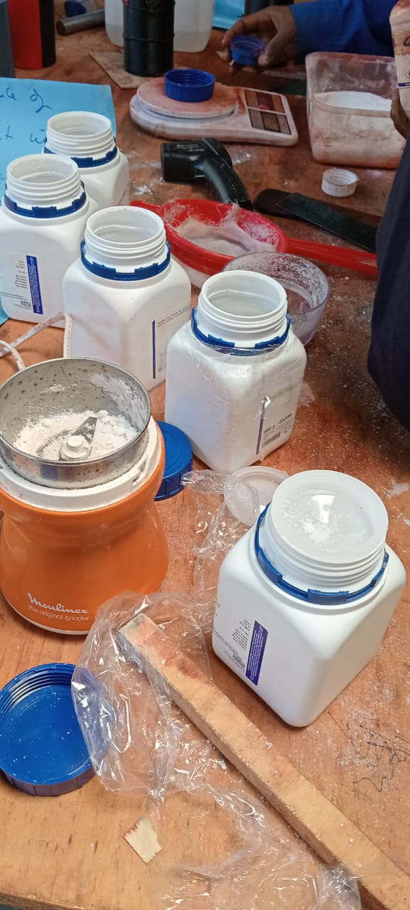
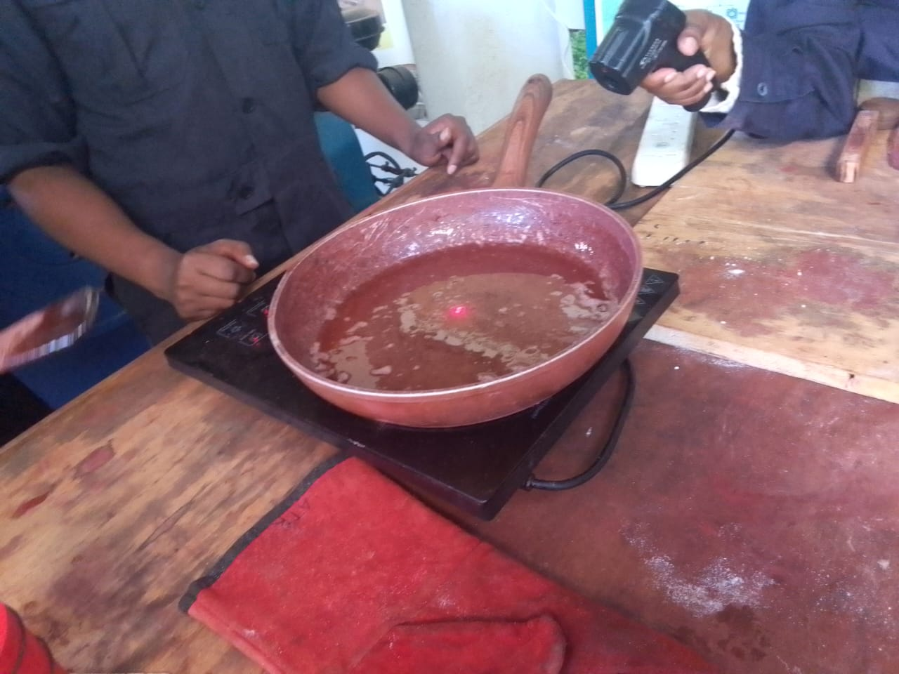
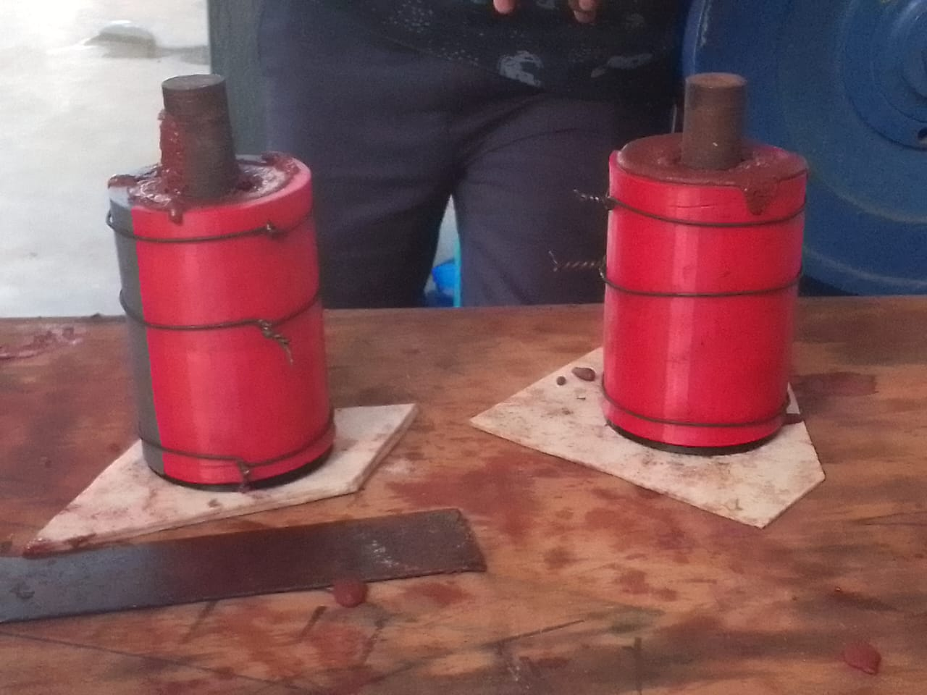
Cooking of grains
Mixing of grinded Potassium, Iron(iii) Oxide and added the heated sorbitol

Slide 5

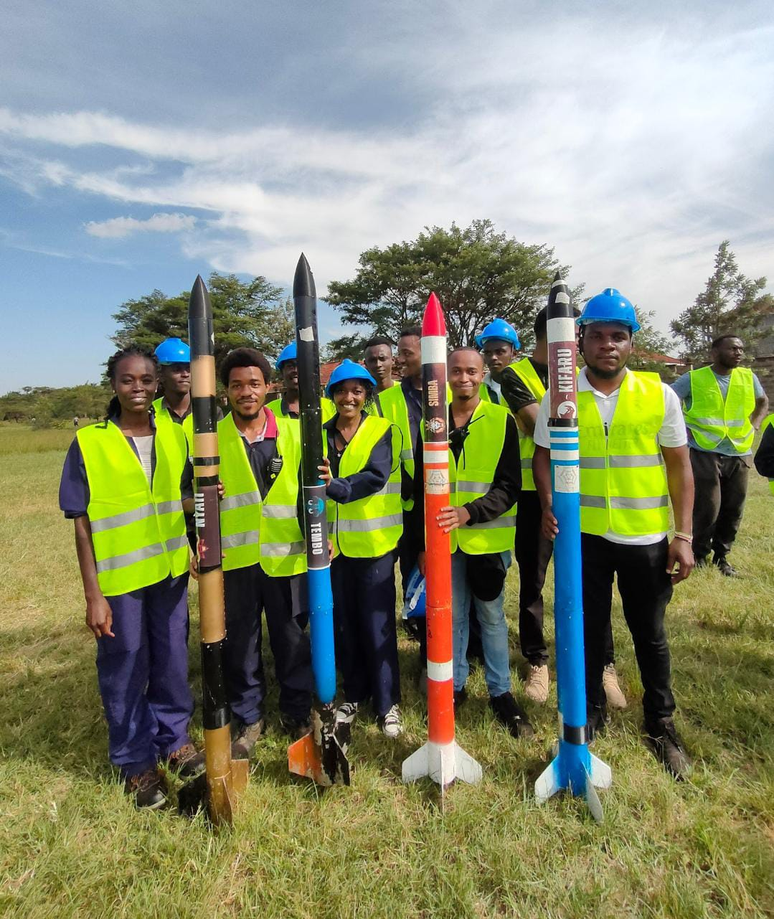
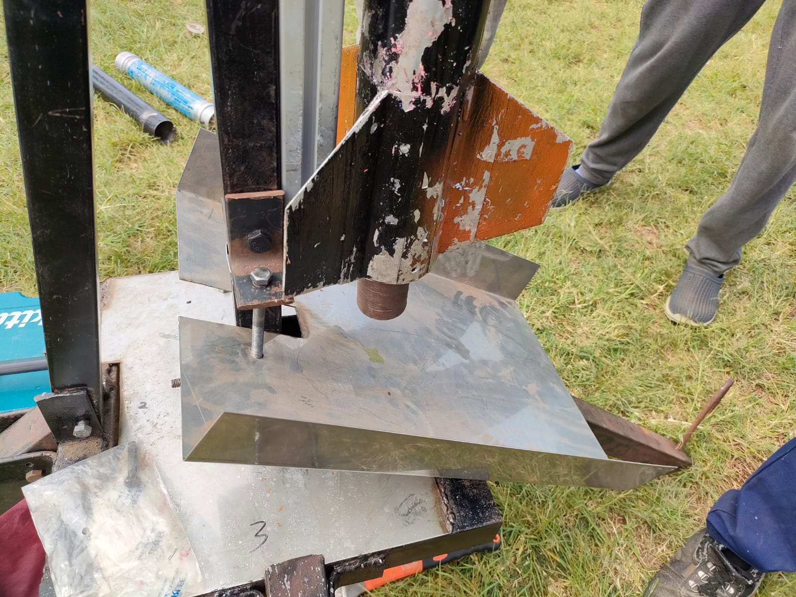
Dry Run Participation
Confirmation of the checklist of task allocation and items
Assembling of the airframe

Slide 6
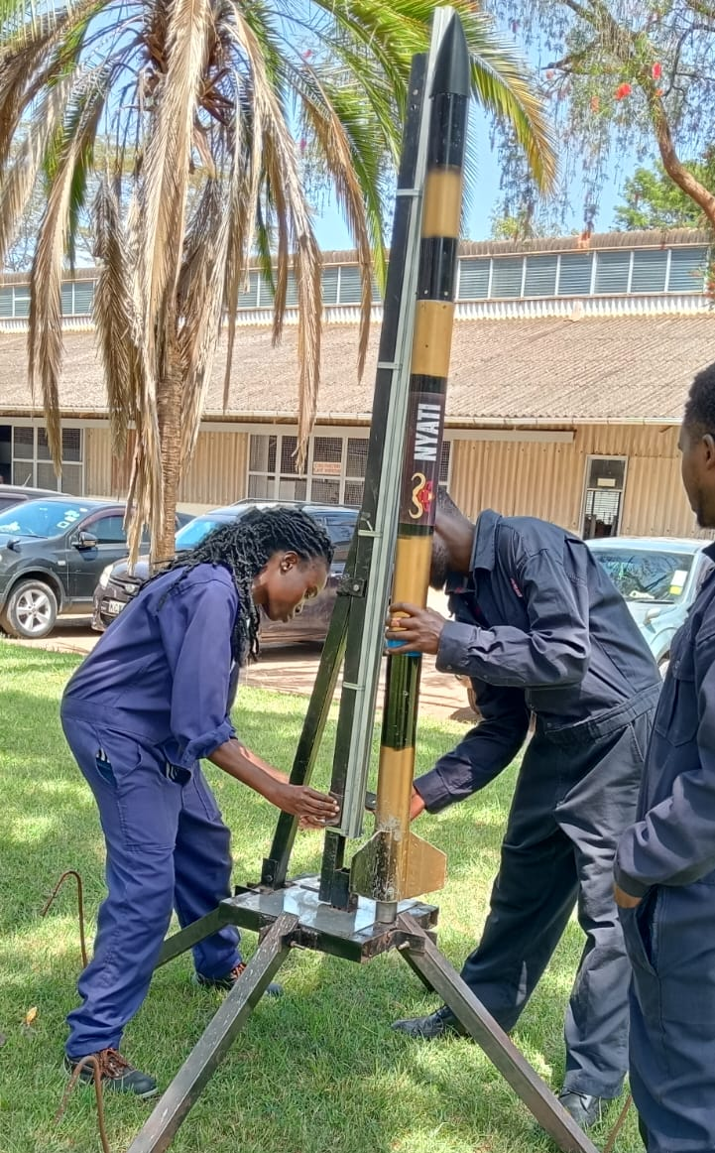
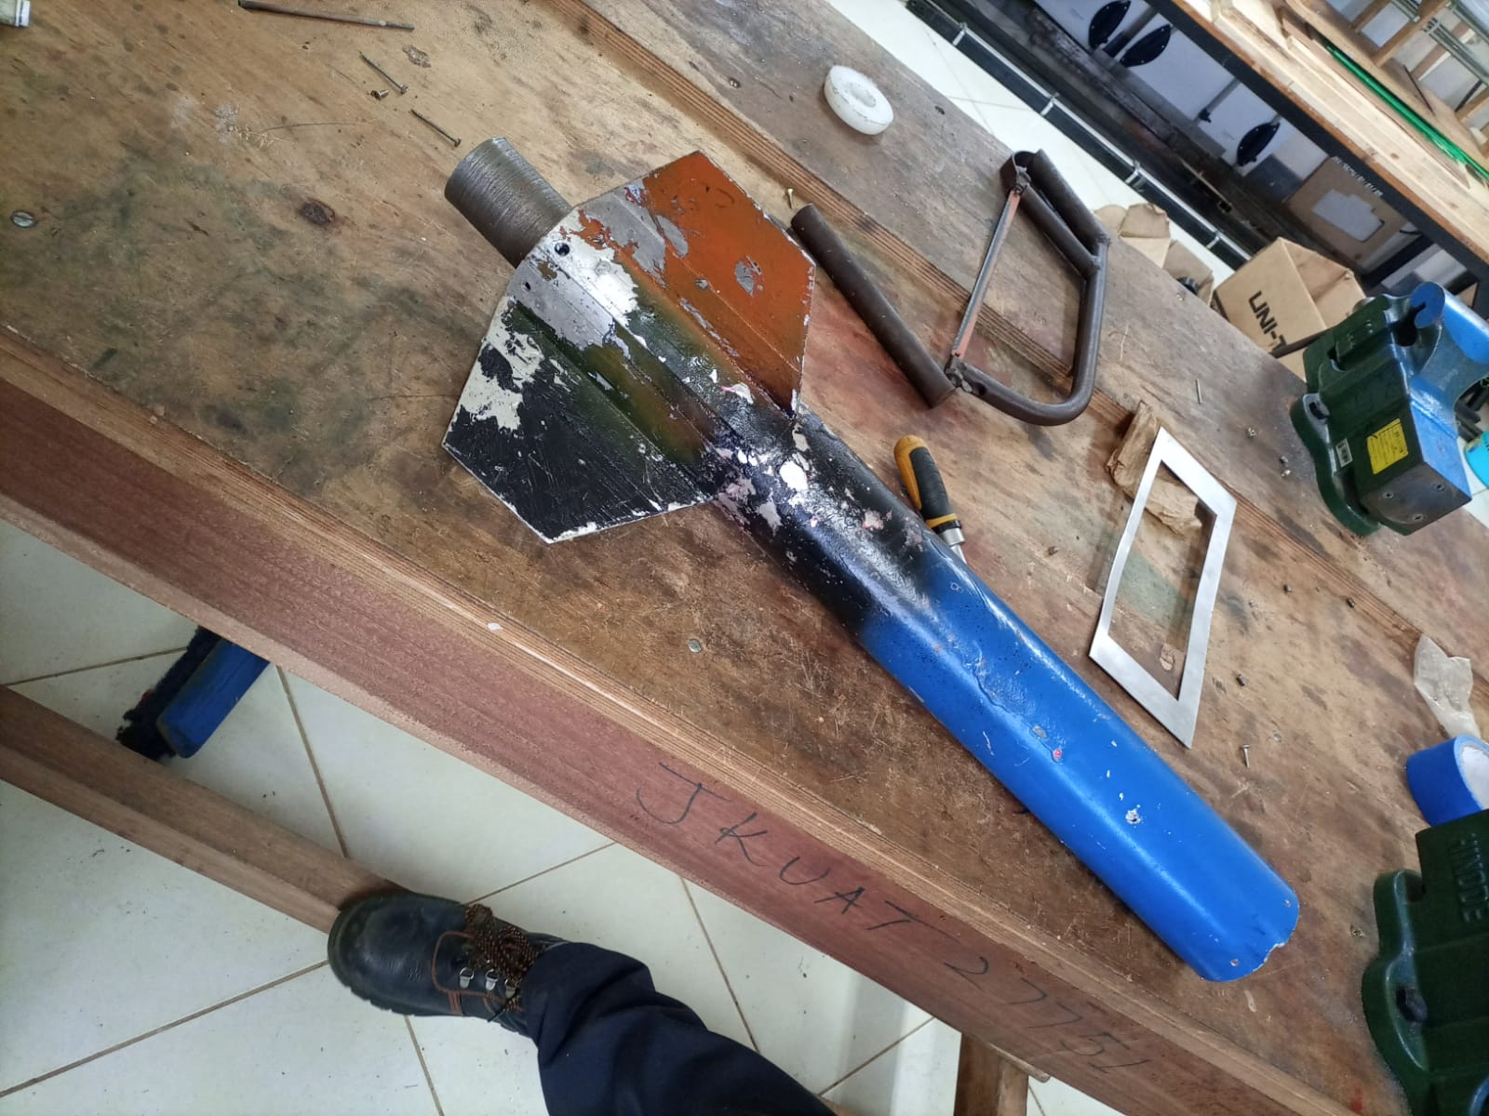
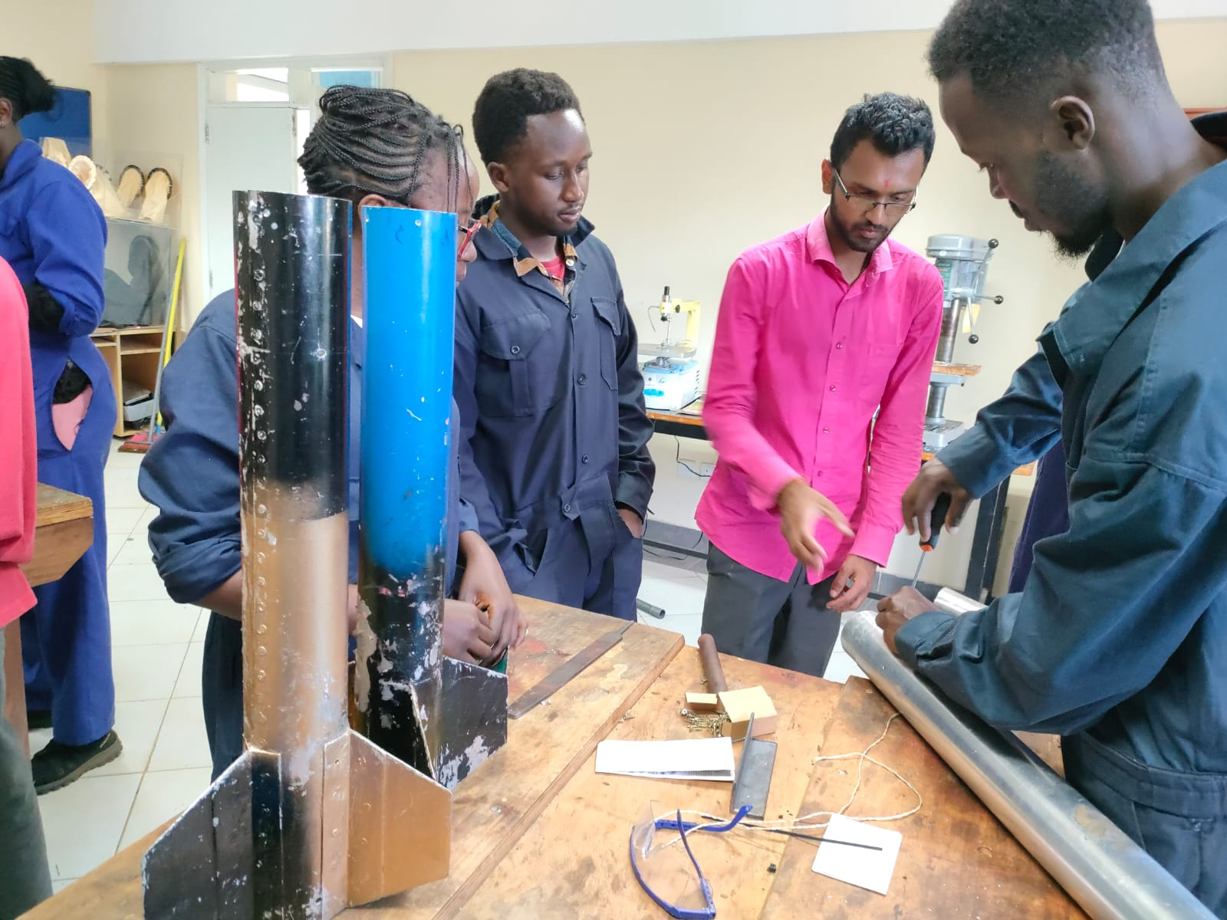
N3 Launch Preparation
Assembly of the launch pad ensuring everything is in place i.e. deflector plate, pegs, bolts and nuts
Assembly of the museum piece
Aligning and bolting of the motor casing on the rear end of the airframe casing

Slide 7
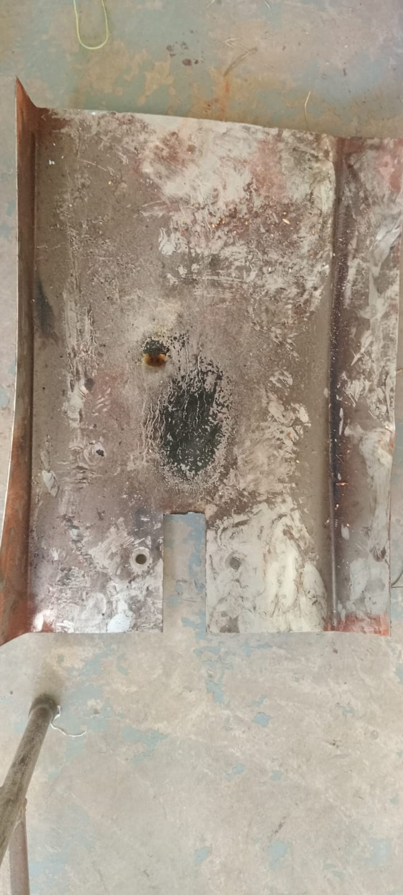
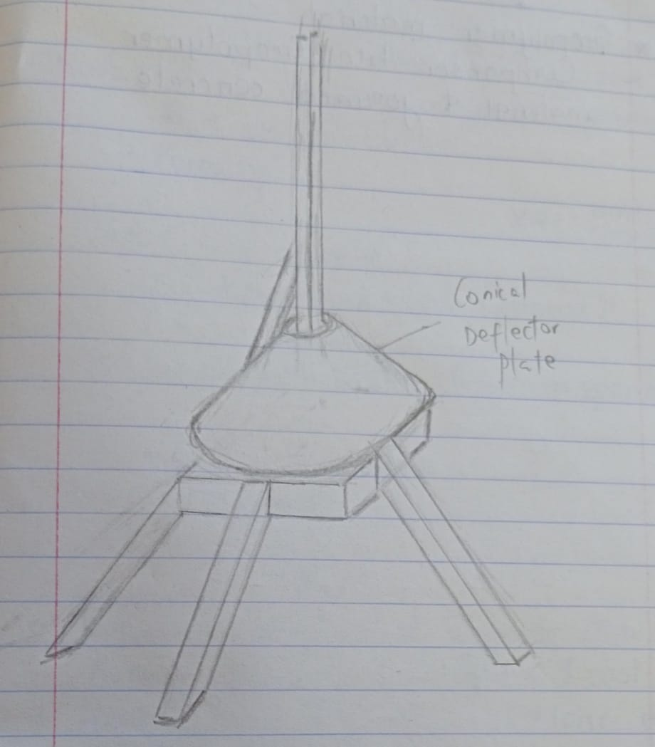
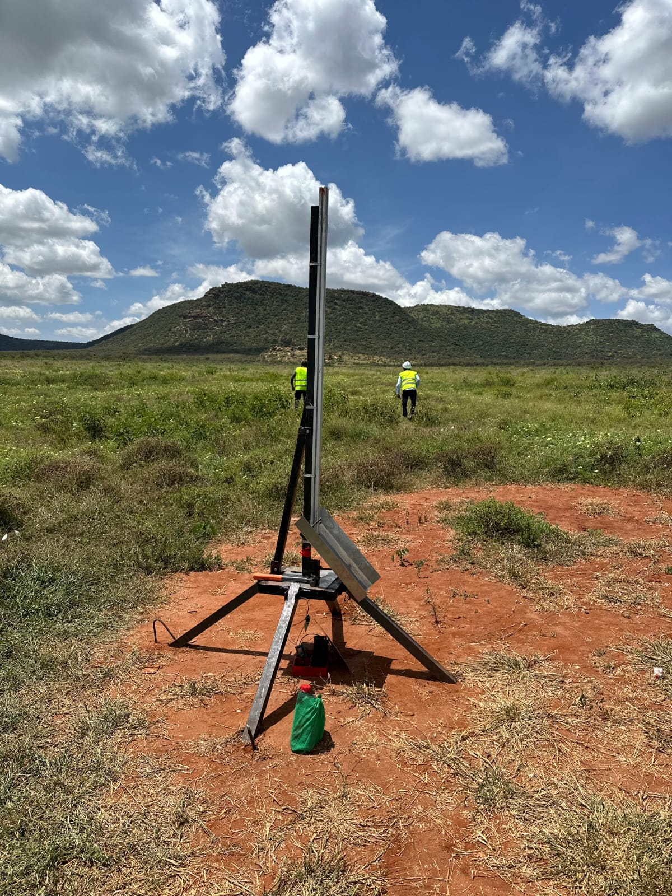
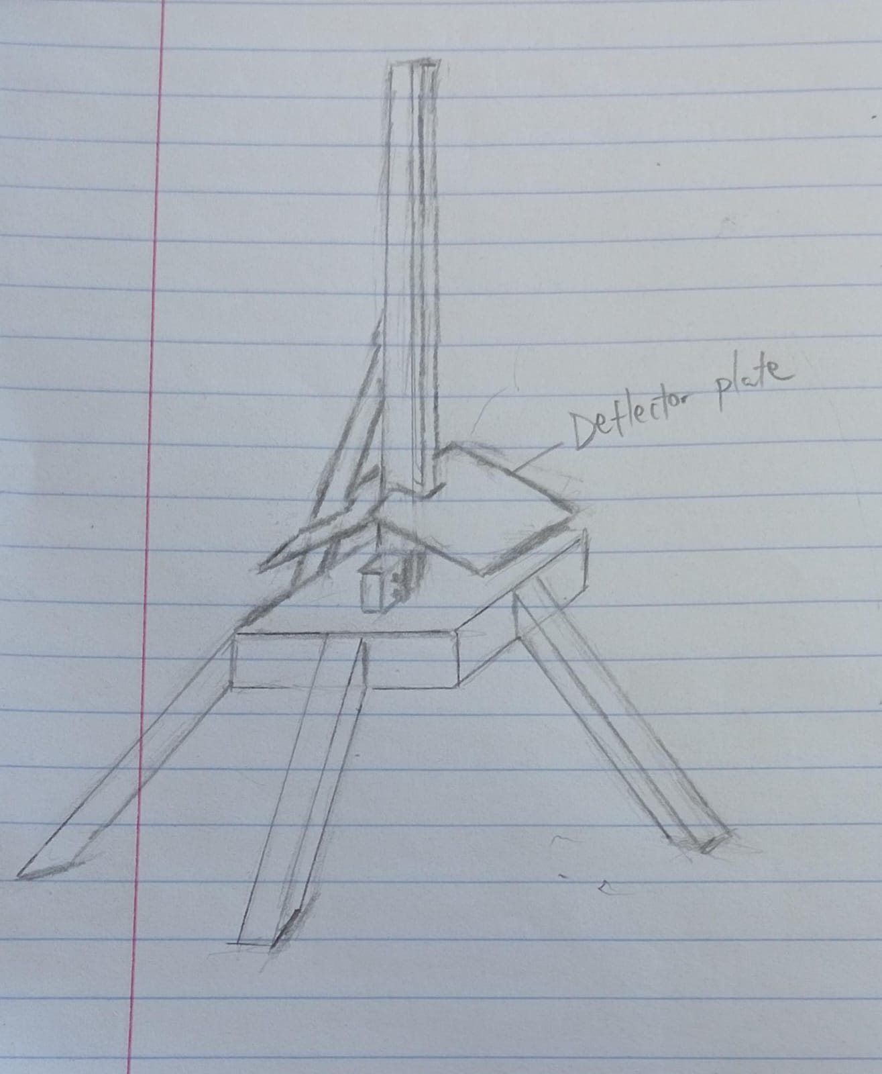
Remaining Tasks
Research on various design of the deflector plate

Slide 8
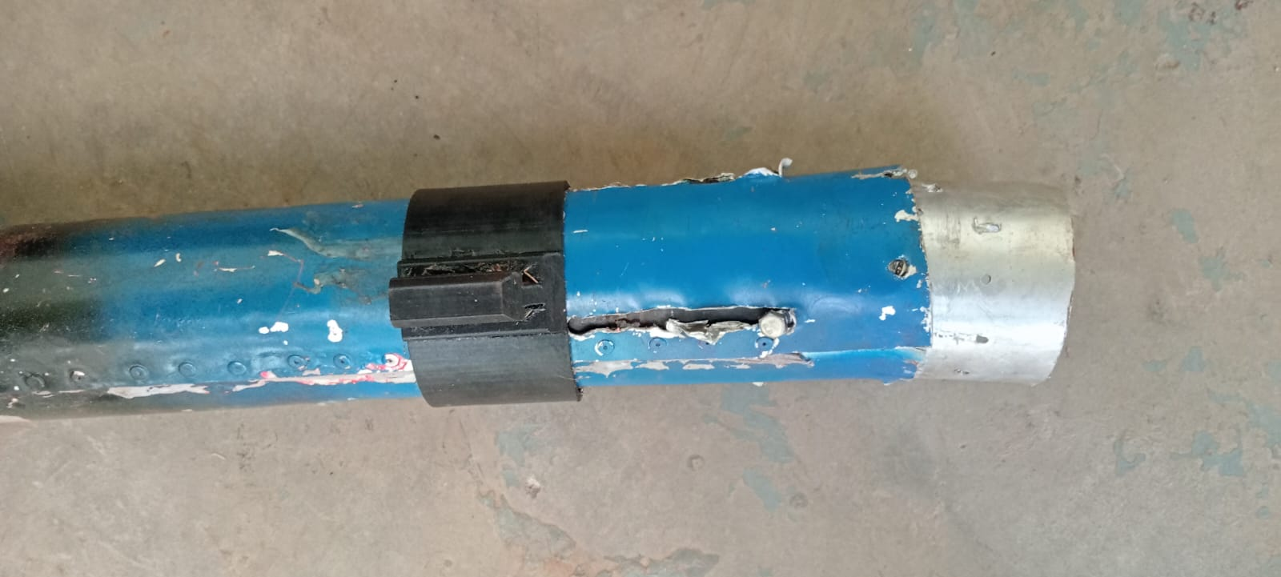
Key consideration in material selection
Strength: Requirement for material to withstand forces during launch
Weight :Importance of light weight material for fuel efficiency
Availability: The ease of accessing the material
Thermal resistance: Able to withstand high temperatures and pressure

Slide 9
Material in consideration
material | advantages | disadvantages
Aluminum alloy Grade AA6061 | Light weight High corrosion resistance Easy to machine | Welding challenges Low melting point (585 ⁰C )
Al-Ti alloy | High strength to weight ratio Low thermal conductivity Good corrosion resistance | Complex to weld Expensive
carbon fiber reinforced plastic A composite where the Matrix – Epoxy resin Fiber – carbon fiber | High strength to weight ratio High corrosion resistance High stiffness and rigidity | They are brittle Have anisotropic properties

Slide 10
Next week objectives
Research and understanding of simulation software i.e. OpenRocket and ANSYS
Perform flight simulation using OpenRocket
Re-designing of the launch pad
Designing of the nose cone

Slide 11
THANK YOU

